Slide 1
Department Research Colloquium 2026
RAP twin: A Digital Twin and Planning Sandbox for Distributed Systems
• Riaan Masoud Attar (first author) • Avanti Nitin Patil • Preet Prashant Boralkar
• Faculty Mentor: Prof. K. K. Deshmukh
• Department of Artificial Intelligence and Data Science
• K. K. Wagh Institute of Engineering Education and Research, Nashik
• Group 01 | 30 October 2026

Slide 2
Abstract
• Evaluating job-scheduling policies for edge, multi-cloud and hybrid fabrics on production hardware is risky and costly. RAP twin is a digital-twin and planning sandbox that mirrors a 100-node heterogeneous fabric from YAML descriptors and live telemetry. It plans multi-stage jobs with seven pluggable strategies, injects deterministic faults, heals itself, and scores every plan for latency, energy, cost and carbon. On the reference fabric, five strategies place identically in dry-run, Resilient predicts 19% higher latency and about 40× the cost in exchange for redundancy, and RL-Markov leaves 3 of 11 jobs infeasible under contention. A chaos-as-CI gate and a 1,000-trial Monte-Carlo sweep make these trade-offs reproducible. The study reports its measured results and known limits openly.
Keywords: digital twin • distributed systems • task scheduling • chaos engineering • Monte-Carlo simulation • edge computing
• RAP twin | Group 01 | Department Research Colloquium 2026
2

Slide 3
Introduction and Motivation
Mixed fabrics
Deadline pipelines
Risk on production
• Servers, workstations, single-board computers, phones and HPC nodes with different CPUs, GPUs, links and reliability
• Jobs are multi-stage pipelines with SLAs; placement balances latency, energy, cost, carbon and risk
• Trying a new scheduler live is dangerous: link outages and thermal throttling cause real failures
Digital twins
RAP twin
• A synchronized virtual copy lets policies be tried safely [1]–[3]
• One sandbox uniting planning, fault injection, self-healing and benchmarking
• RAP twin | Group 01 | Department Research Colloquium 2026
3

Slide 4
Problem Definition and Research Gap
Problem
Research gap
• Choose, for every stage of a job, a node that meets resource and format limits while balancing latency, energy, cost, carbon and risk
• Keep the job alive when nodes or links fail
• Twin offloading studies focus on learning algorithms (multi-agent / federated deep RL) [4], [5], not a reusable sandbox for comparing planners
• Chaos tools target software and containers, largely ignoring physical-layer faults [6], [7]
• No single sandbox found combining live twin, several planners, chaos testing, cost/carbon accounting and a regression gate
• Aim: report measured trade-offs and defects openly
• RAP twin | Group 01 | Department Research Colloquium 2026
4

Slide 5
Objectives and Scope
Objectives
In scope
1. Multi-strategy planning: Greedy, Cheapest-Energy, Cheapest-Cost, Greenest, Bandit, Resilient, RL-Markov
2. Real-time state sync: YAML + live telemetry (REST / MQTT)
3. Predictive analytics and self-healing
4. Deterministic chaos engineering and a chaos-as-CI gate
5. Large-scale Monte-Carlo benchmarking
6. What-if capacity and blast-radius analysis
7. Interoperability: Kubernetes import, Azure DTDL / CRD export
• Simulated policy evaluation
• Dashboard, REST API, benchmarks
Out of scope
• Running real workloads
• Production scheduler
• Training deep RL agents
• Live 5G/6G test-bed
• RAP twin | Group 01 | Department Research Colloquium 2026
5

Slide 6
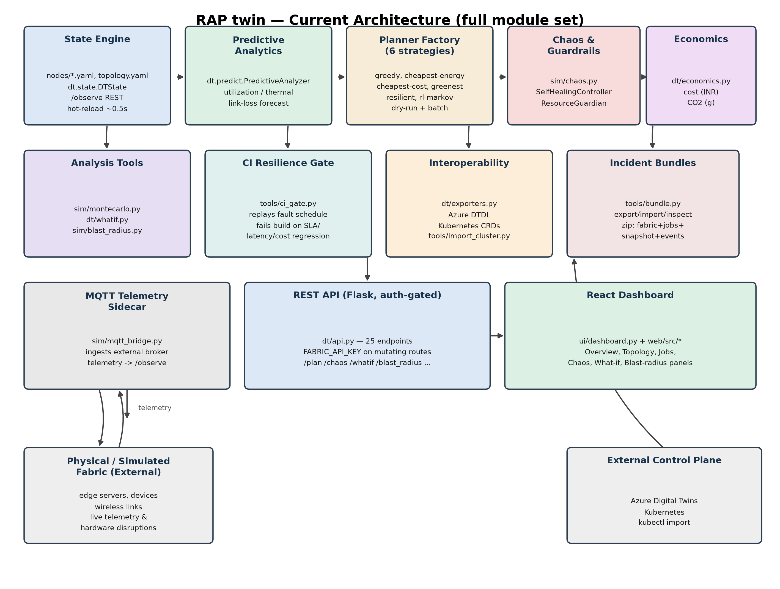
System Architecture
Layers
• Presentation: REST/SSE API, React dashboard
• Orchestration: planner factory, chaos runner, self-heal, guardian
• Decision: planners, cost model, economics, predictor
• State: DTState, event bus, validators
• Data: YAML descriptors, topology, overrides, jobs
RAP twin layered architecture
• RAP twin | Group 01 | Department Research Colloquium 2026
6

Slide 7
Proposed Methodology
Ingest state
Predict
Plan
Inject faults
Self-heal
Benchmark
State and prediction
Planning engine
• DTState merges YAML + telemetry; hot reload ≈ 0.5 s
• Predictor: utilization, thermal derating, link loss
• Pluggable DAG planners; dry-run and commit modes
• Greedy family, Bandit, Resilient (fallbacks, spread)
• RL-Markov: Tchebycheff over nine cost terms
Chaos and healing
Tools and stack
14 fault kinds: link cut, noise, thermal derate, zone blackout
• SelfHealingController and ResourceGuardian
• Monte-Carlo, CI gate, blast radius, what-if, bundles
• Flask API + React/TypeScript dashboard (SSE)
• RAP twin | Group 01 | Department Research Colloquium 2026
7

Slide 8
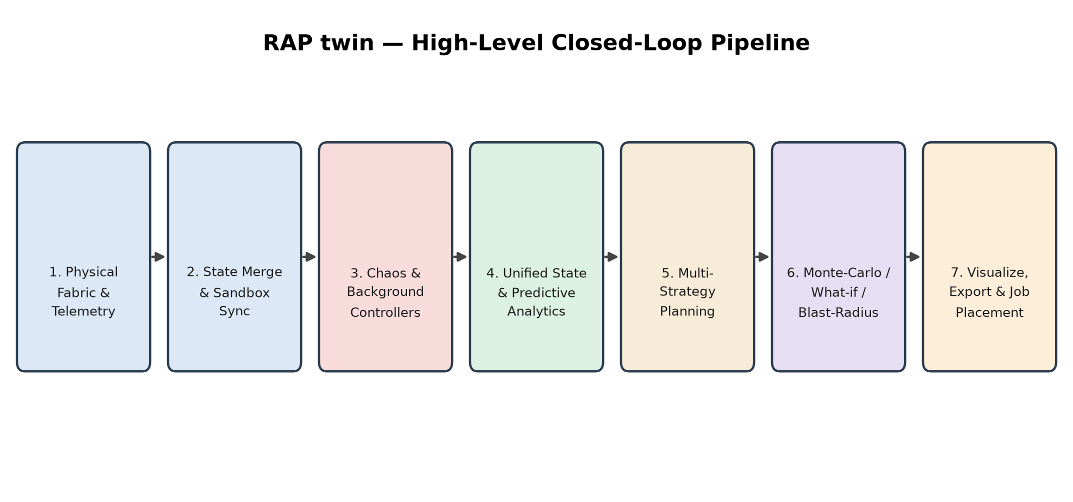
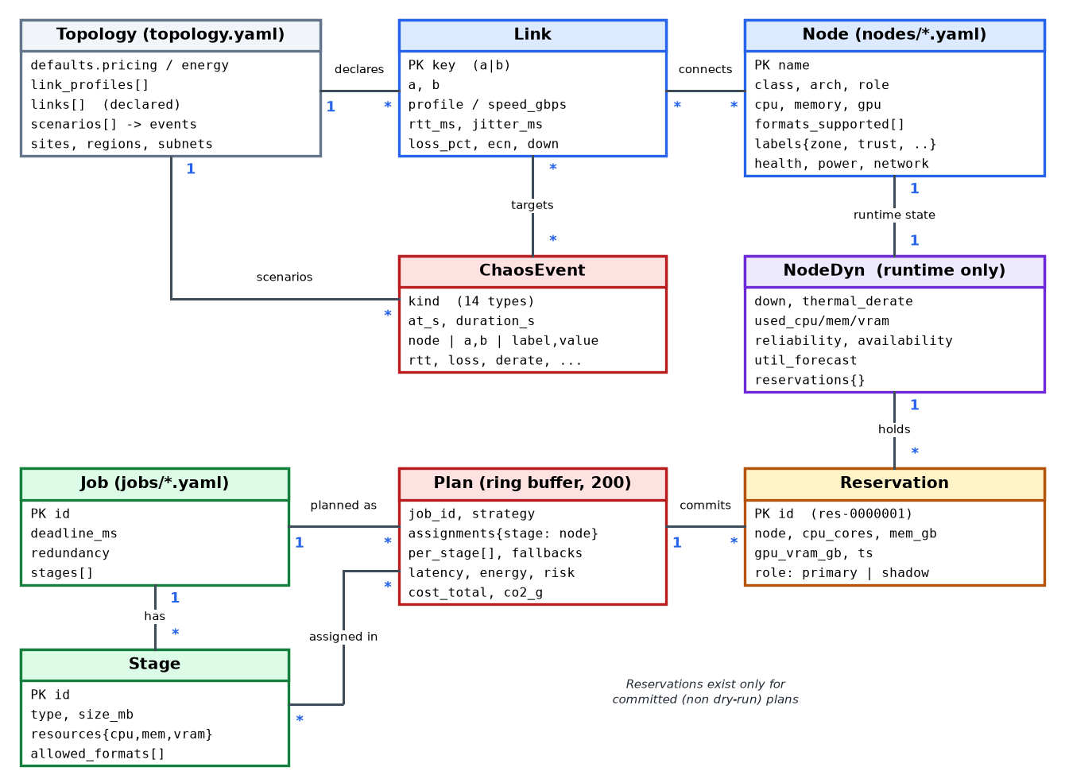
Pipeline and Data Model
Closed-loop pipeline
Three-layer node state
• base: static YAML descriptor + derived caps
• dyn: down, derate, used CPU/mem/VRAM, reliability, reservations
• effective: free capacity = cores x (1 - derate) - used
Entity-relationship diagram
• RAP twin | Group 01 | Department Research Colloquium 2026
8

Slide 9
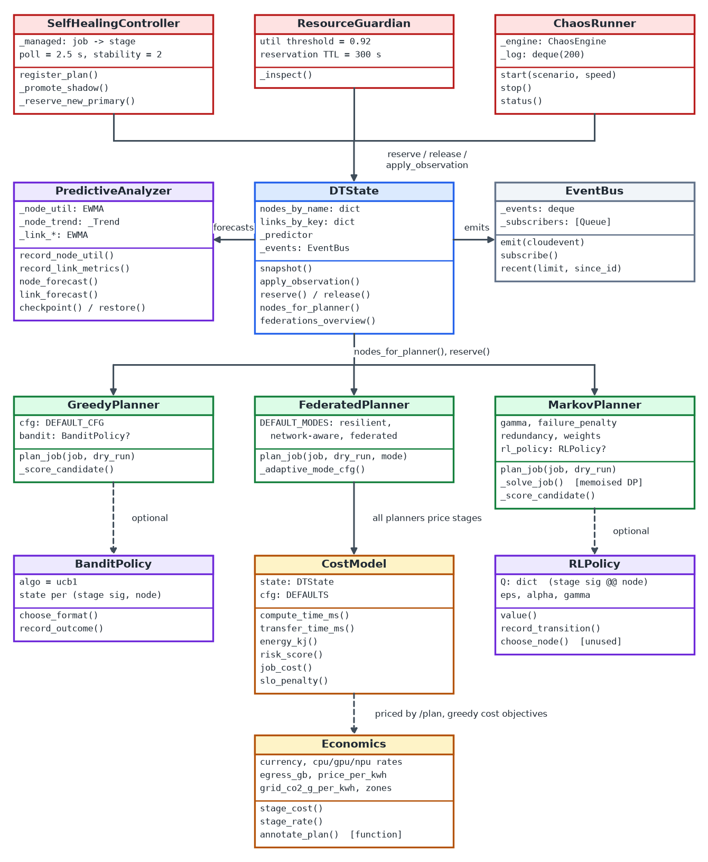
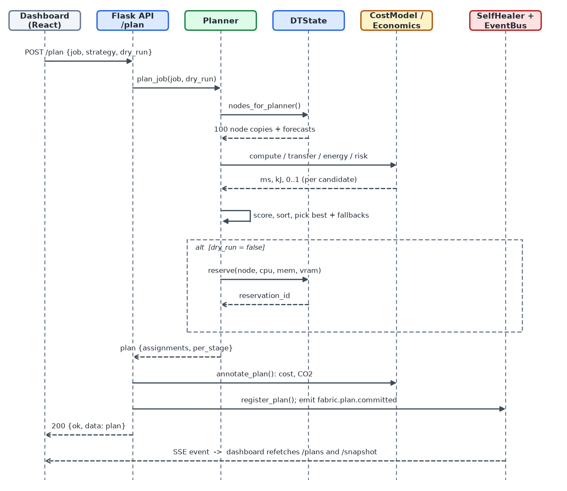
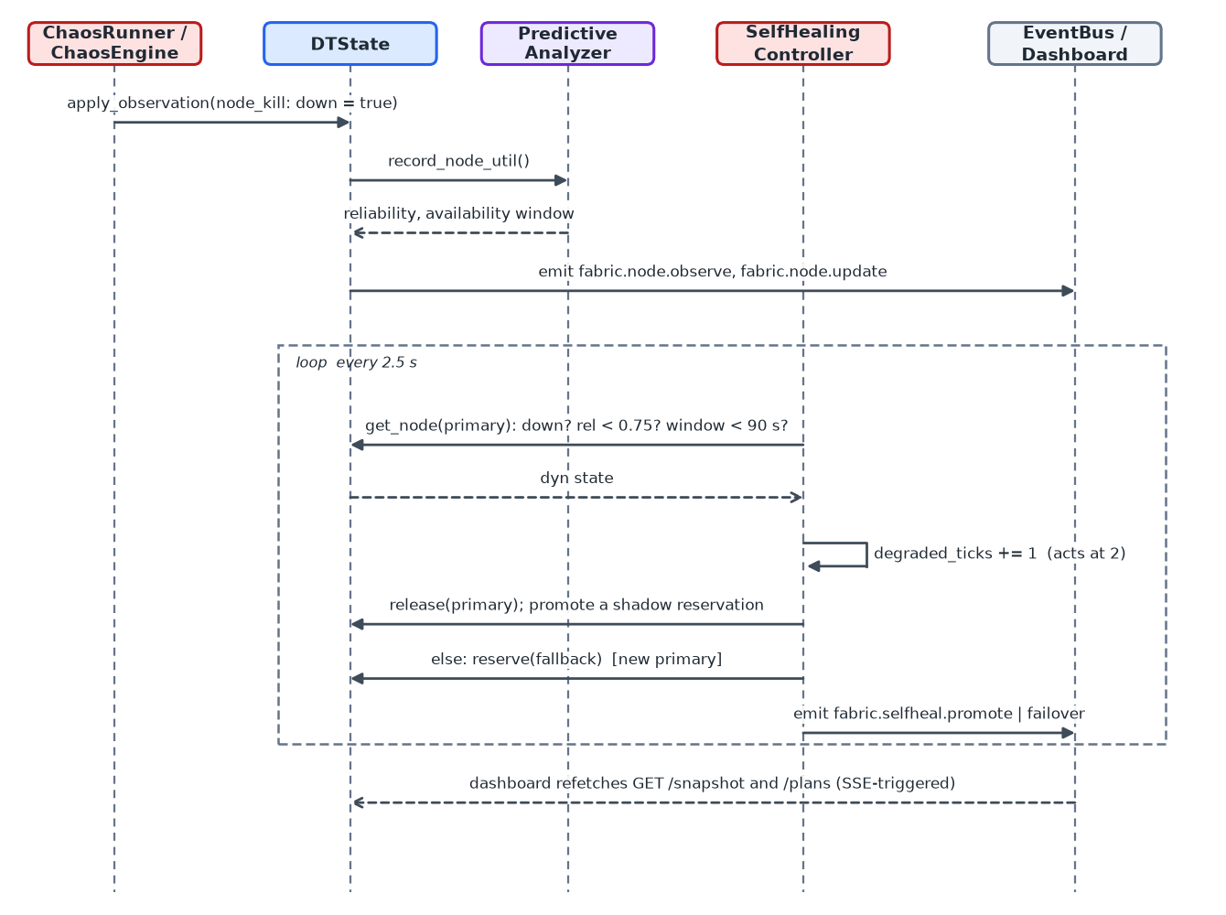
Class and Sequence Design (UML)
Fault and self-healing
Planning a job
Class diagram (dt/ core)
• RAP twin | Group 01 | Department Research Colloquium 2026
9

Slide 10
Strategies and Cost Model
Strategy | Class | Objective
greedy | GreedyPlanner | compute + transfer + 10*risk
cheapest-energy | GreedyPlanner | + 0.1 ms per kJ
cheapest-cost | GreedyPlanner | + 25 ms per Rs/hour
greenest | GreedyPlanner | + 25 ms per gCO2/hour
bandit | Greedy + UCB1 | learns execution format
resilient | FederatedPlanner | additive ms score, fallbacks
rl-markov | MarkovPlanner | MDP + Tchebycheff, gamma 0.92
Cost model (per stage)
• Compute: W = 2*size + 120*cores; t = W/(units/10*accel)*(1+0.35*util) + 6000*(1-reliability)
• Transfer: 8*size/(speed*850*(1-loss)) + RTT + jitter
• Energy: P*(0.12 + 0.88*u^0.85)*t
• Risk: weighted blend of trust, wear, crashes, derate, loss, reliability, availability
• SLO penalty: ((L/D)^1.2 - 1)/0.002
• Cost: rental + electricity + egress; CO2 = kWh x 720 g
• RAP twin | Group 01 | Department Research Colloquium 2026
10

Slide 11
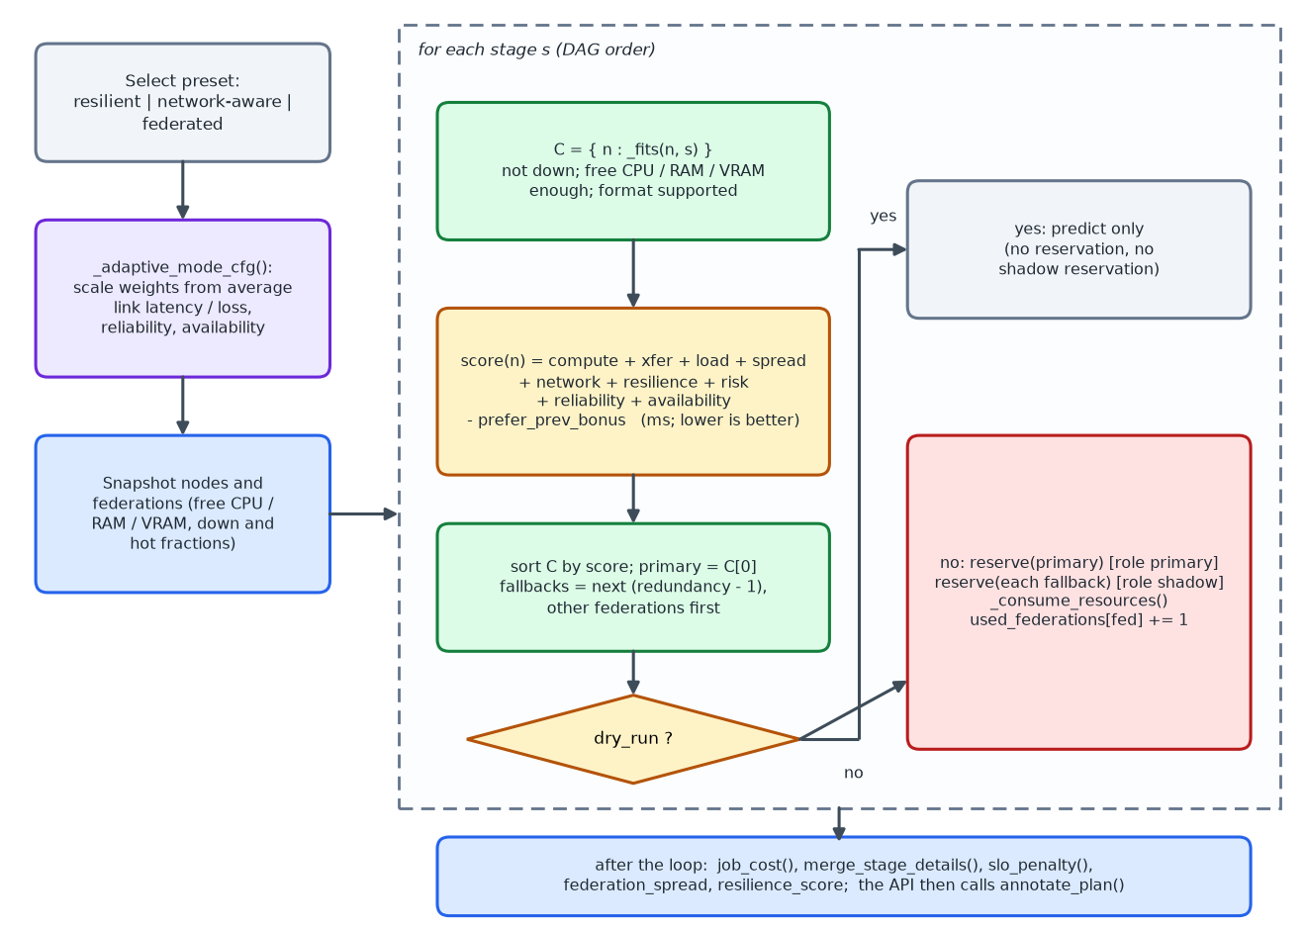
Resilient Planner: Algorithm
Additive score (ms, lower is better)
• compute + xfer + load + spread + network + resilience + risk + reliability + availability - prev-bonus
Preset | Redund. | Load | Spread | Net
resilient | 2 | 380 | 210 | 240
network-aware | 1 | 260 | 140 | 300
federated | 3 | 360 | 260 | 230
• Fallbacks prefer other federations; committed plans reserve shadow nodes that the self-healer can promote instantly.
Flowchart of the resilient planner
• RAP twin | Group 01 | Department Research Colloquium 2026
11

Slide 12
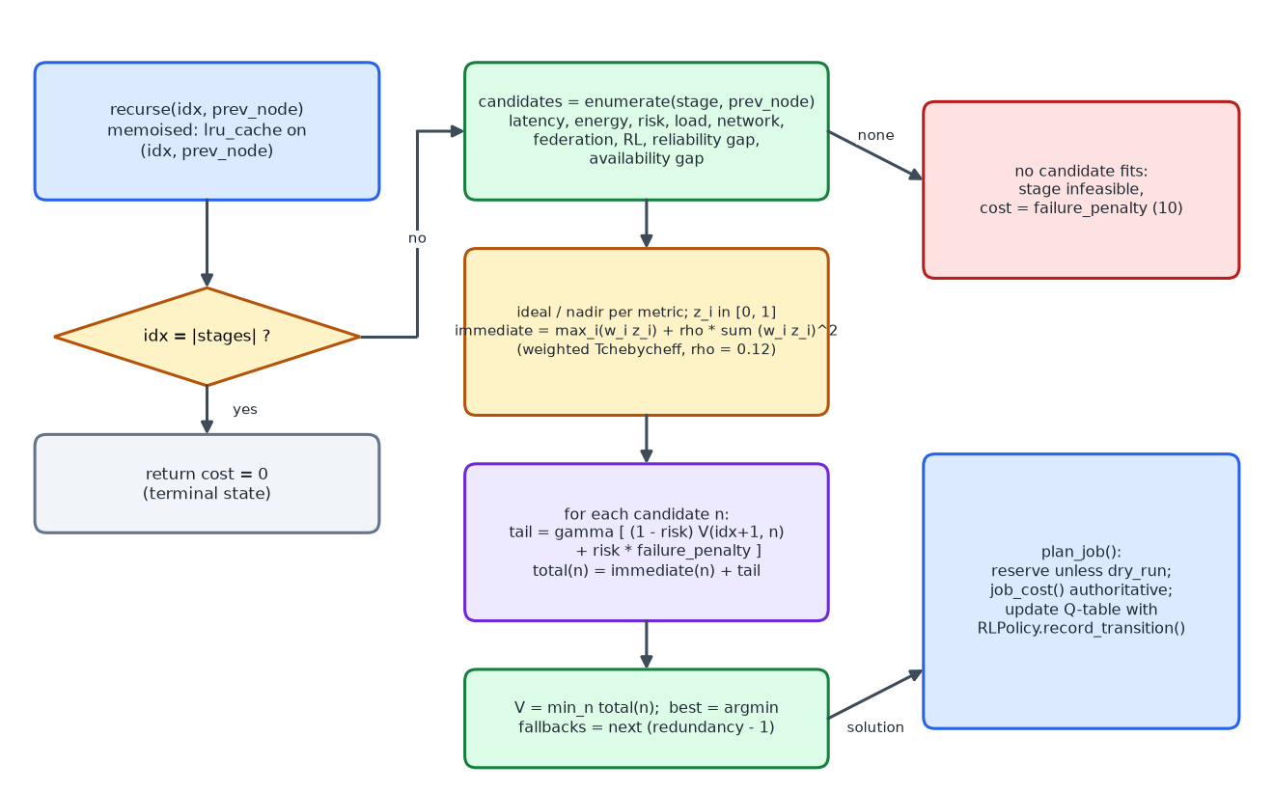
RL-Markov Planner: MDP
Bellman recursion
• V(i,p) = min_n [ c_i(n) + gamma((1-rho_n) V(i+1,n) + rho_n F) ]
• gamma = 0.92, failure penalty F = 10
Criterion | Weight
latency | 0.34
risk | 0.16
energy | 0.14
load | 0.10
network | 0.08
federation | 0.06
RL, reliability, availability | 0.04 each
Memoised dynamic-programming recursion
• Complexity O(m*|N|^2): about 35,000 cost evaluations per job, hence 1.6 s planning. Caveat: stages are scored against an unmodified snapshot, so they can be stacked on one node.
• RAP twin | Group 01 | Department Research Colloquium 2026
12

Slide 13
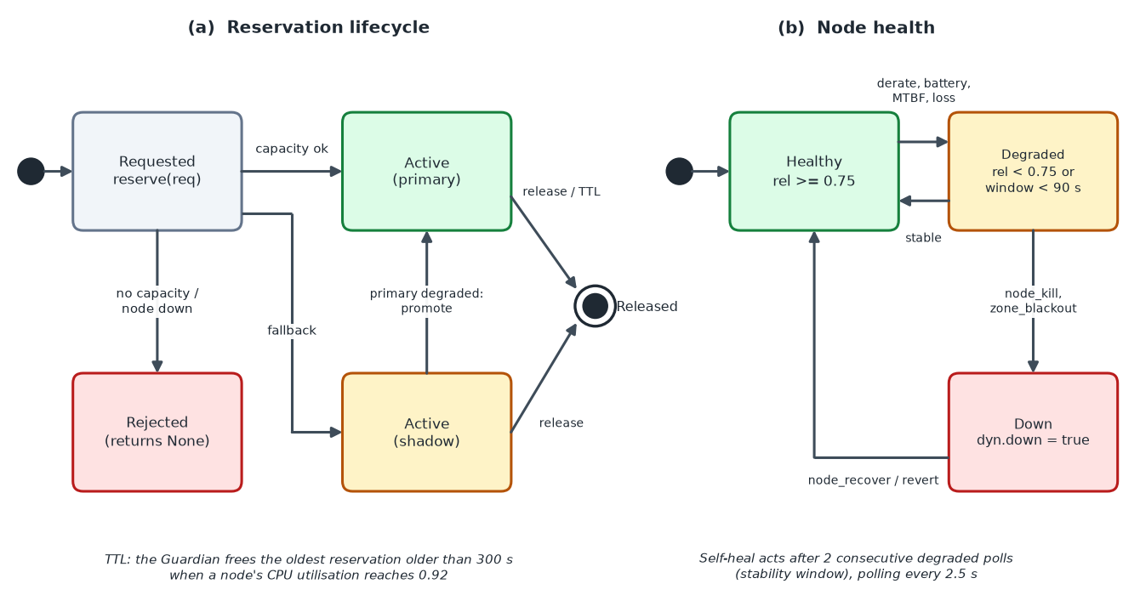
Chaos Engine, Self-Healing and CI Gate
Family | Event kinds
Link (4) | degrade, loss_spike, down, up
Node (7) | kill, recover, power_cap, thermal_derate, clock_skew, packet_dup, packet_reorder
Group (3) | zone_blackout, zone_recover, federation_partition
CI gate
• Replays faults; fails build on SLA/p95/cost regression vs baseline (seed 7, deadline scale 0.28)
Reservation lifecycle and node health
Self-healing
Analysis tools
• Poll 2.5 s; degraded if down, reliability < 0.75 or window < 90 s
• Acts after 2 polls: promote shadow, else fail over; Guardian frees stale reservations
• Blast radius: BFS minimal breaking fault sets
• What-if: fork twin, apply change, diff
• Monte-Carlo: seeded trials, mean/p95/p99
• RAP twin | Group 01 | Department Research Colloquium 2026
13

Slide 14
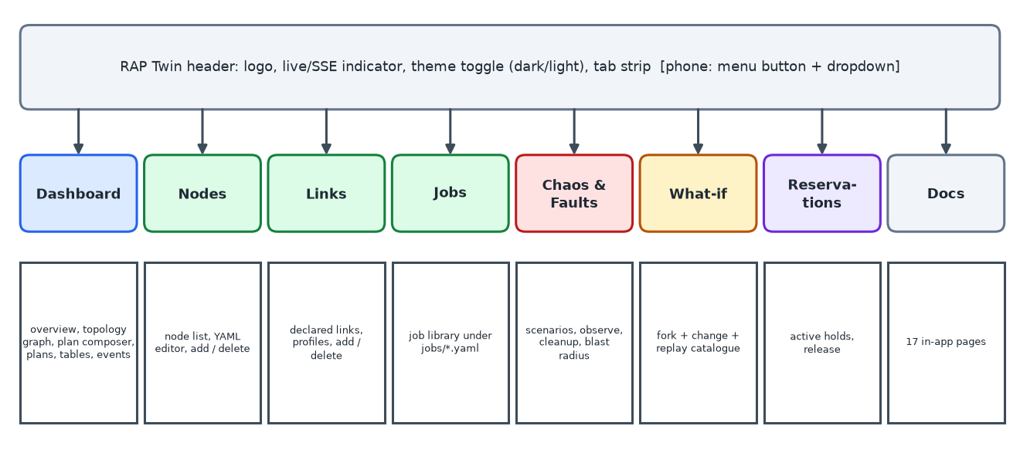
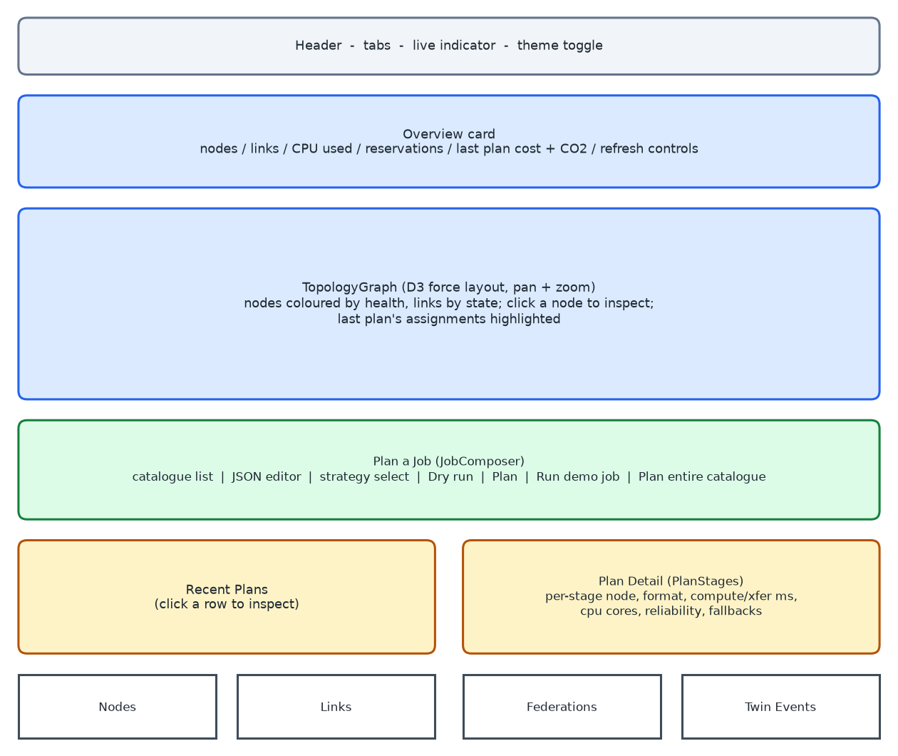
Dashboard (UI)
Eight tabs of the dashboard
Features
Dashboard tab composition
• Live updates via SSE; dark/light theme; phone-friendly menu
• Plan composer with dry-run, 17-page in-app docs, per-stage plan detail
• Chaos, blast radius, what-if, reservations, incident bundle download
• RAP twin | Group 01 | Department Research Colloquium 2026
14

Slide 15
Experimental Setup
100
2,022
10,508 GB
51
11 / 36
nodes, 7 classes, 7 zones
CPU cores
RAM
GPU nodes
jobs / stages
• Fabric: links from 1 Gbps WAN to 400 Gbps InfiniBand
• Workload: vision, NLP, analytics, audio, tabular, HPC and mixed-accelerator jobs, each with a deadline
• Experiments: (a) dry-run comparison (b) committed planning with contention (c) chaos gate under zone events (d) 1,000-trial Monte-Carlo (e) what-if and blast radius
• Benchmark table: commit 2e7962d, seed 7, first 6 jobs, deadline scale 0.28
• All results come from the project's own tools and are reproducible
• RAP twin | Group 01 | Department Research Colloquium 2026
15

Slide 16
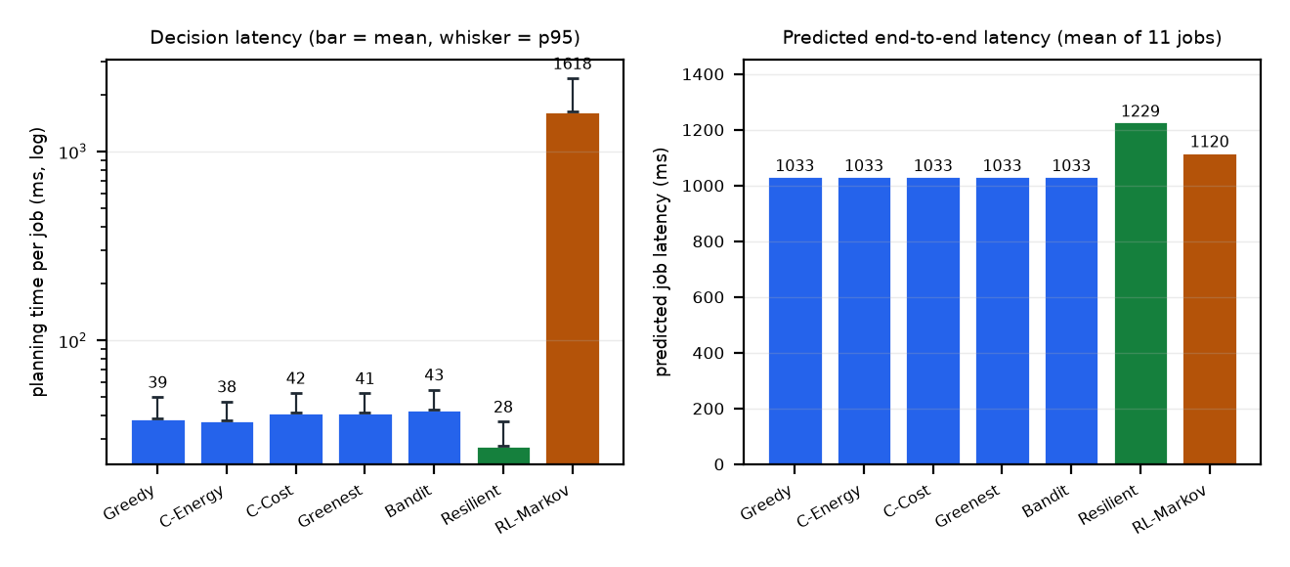
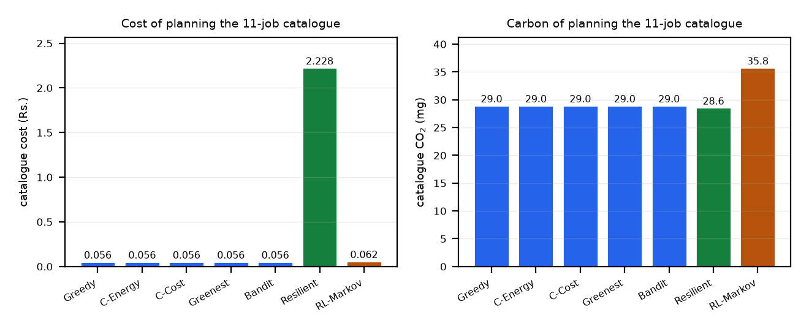
Results: Dry-Run Strategy Comparison
Strategy | Plan ms | Latency ms | Energy kJ | Cost Rs | CO2 mg
Greedy | 38.7 | 1,033 | 0.1406 | 0.0563 | 29.0
Cheapest-Energy | 37.6 | 1,033 | 0.1406 | 0.0563 | 29.0
Cheapest-Cost | 41.5 | 1,033 | 0.1406 | 0.0563 | 29.0
Greenest | 41.4 | 1,033 | 0.1406 | 0.0563 | 29.0
Bandit | 43.1 | 1,033 | 0.1406 | 0.0563 | 29.0
Resilient | 27.7 | 1,229 | 0.1417 | 2.2284 | 28.6
RL-Markov | 1,617.8 | 1,120 | 0.1782 | 0.0622 | 35.8
• Five strategies place all 36 stages on hpc-080
• Resilient: 97% of cost is cross-zone egress (2.9 zones/job)
• Greedy planning 38.7 ms vs SRS target 5 ms: about 60% is node-table copying
• RAP twin | Group 01 | Department Research Colloquium 2026
16

Slide 17
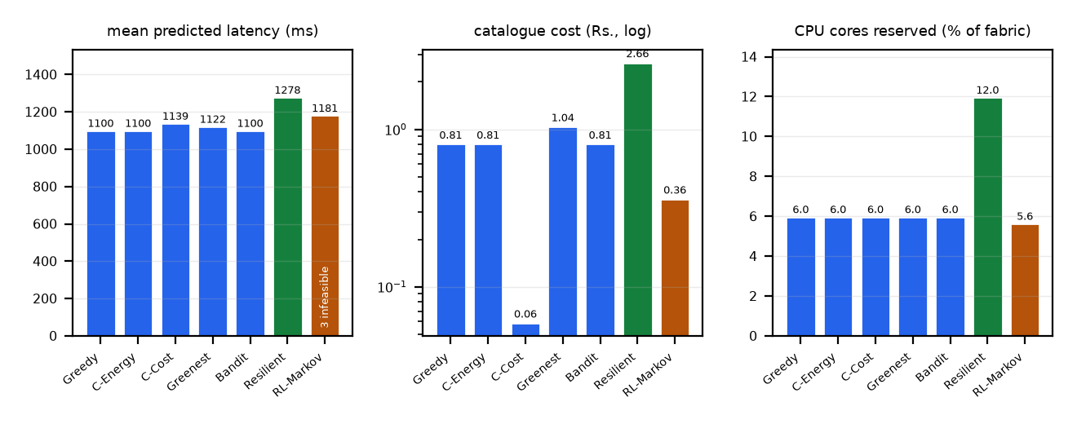
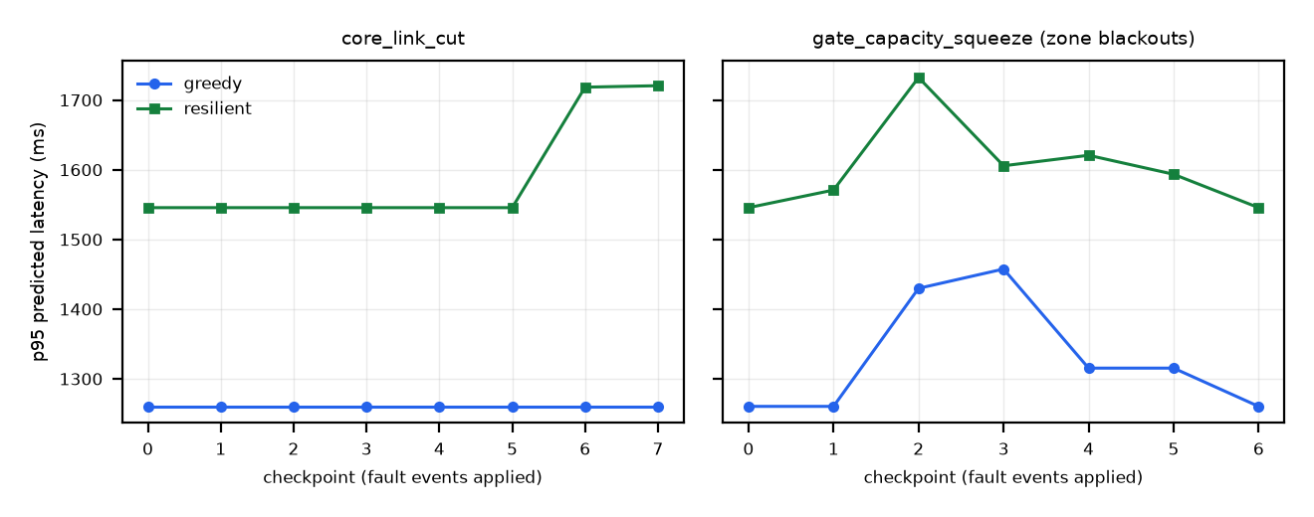
Results: Contention, Gate and What-If
Strategy | Infeas. | Mean ms | Cost Rs | Reserv.
Greedy | 0 | 1,100 | 0.808 | 36
Cheapest-Cost | 0 | 1,139 | 0.059 | 36
Greenest | 0 | 1,122 | 1.042 | 36
Resilient | 0 | 1,278 | 2.659 | 72
RL-Markov | 3 | 1,181 | 0.362 | 33
What-if change | Deadlines | p95 ms | Cost Rs
+2 x srv-015 | 11 to 11 | 1,409 to 1,409 | 0.808 to 0.808
- hpc-080 | 11 to 11 | 1,409 to 1,466 | 0.808 to 1.276
- 3 HPC nodes | 11 to 11 | 1,409 to 1,433 | 0.808 to 0.526
• Blast radius: 16 faults, 62 placements; both jobs survive. Monte-Carlo, 1,000 trials: 516 ms mean, 632 ms p99, 100% SLO.
p95 latency per gate checkpoint
• RAP twin | Group 01 | Department Research Colloquium 2026
17

Slide 18
Testing and Known Limitations
Suite | Tests
API + auth + management | 34
CI gate | 19
Economics | 11
Blast radius | 13
What-if | 18
Bundle / import / MQTT / launcher | 61
Benchmarks | 10
Total (all pass) | 166
Limitation | Effect
Link p95 forecast uses accumulator | about 7e12 ms on registered links
Trend with epoch-ms timestamps | 30 s look-ahead inert
WASM penalty clamped | no effect
MDP ignores in-job capacity | 3/11 jobs infeasible
core_link_cut targets absent nodes | no effect on plans
Schemas / validators not wired | 25/100 nodes fail
Predictions, not executions | single seed
166 tests pass in 8.6 s; the gate is deterministic (byte-identical reruns).
• RAP twin | Group 01 | Department Research Colloquium 2026
18

Slide 19
Conclusion and Future Scope
Conclusion
Limitations
Future scope
• Working, deployed sandbox with 166 passing tests
• No strategy wins every metric
• Rate-based carbon/cost objectives are proxies
• Gate, scripts and honest limits are results themselves
• Latencies are model predictions, not executed workloads
• Single seed
• Over-provisioned fabric
• Algorithm recommendation: rank strategies per job
• Fix RL-Markov capacity accounting and known defects; re-baseline gate
• Validate against real containers; real RL loop; 5G/6G test-bed
• RAP twin | Group 01 | Department Research Colloquium 2026
19

Slide 20
References and Acknowledgment
[1] Q. Qi et al., "A review of digital twins in smart industries," IEEE Access, vol. 7, pp. 14232–14252, 2019.
[2] A. Fuller et al., "Digital Twin: Enabling technologies, challenges and open research," IEEE Access, vol. 8, pp. 108952–108971, 2020.
[3] Z. Lv et al., "Digital twins: A survey on enabling technologies, challenges, trends, and future prospects," IEEE Commun. Surveys Tuts., vol. 24, no. 1, pp. 54–87, 2022.
[4] C. Xu et al., "Digital twin-driven collaborative scheduling for heterogeneous task and edge-end resource via multi-agent deep reinforcement learning," IEEE JSAC, vol. 41, no. 10, pp. 3056–3069, 2023.
[5] Y. Dai et al., "Federated deep reinforcement learning for task offloading in digital twin edge networks," IEEE TNSE, vol. 11, no. 3, pp. 2849–2861, 2024.
[6] E. Esen, A. Akbulut and C. Catal, "Chaos experiments in microservice architectures: A systematic literature review," Comput. Stand. Interfaces, vol. 97, p. 104116, 2026.
[7] F. Poltronieri, M. Tortonesi and C. Stefanelli, "ChaosTwin: A chaos engineering and digital twin approach for the design of resilient IT services," in Proc. 17th CNSM, 2021.
• Acknowledgment: We thank our guide Prof. K. K. Deshmukh, the Head of Department Prof. Dr. D. V. Medhane, and the Department of AI and DS, KKWIEER, Nashik, for guidance and support.
• RAP twin | Group 01 | Department Research Colloquium 2026
20

